Slide 1
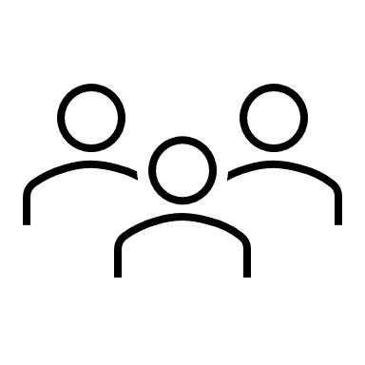


Platform Economy
Consumers/Users
Supply/Producers
Digital Platforms
Ecosystems

